Slide 1

Bourelou Evangelia
May 2018
PROJECT
Modelling of 2D flow around an airfoil in incompressible & compressible flow
(ANSYS CFX Student License)
ARISTOTLE UNIVERSITY OF THESSALONIKI
FACULTY OF ENGINEERING
DEPARTMENT OF MECHANICAL ENGINEERING

Slide 2

Contents
Summary
Mesh
Coarse & fine mesh
Turbulence models
Boundary conditions
Results: Angle of attack = 0°, Spalart – Allmaras
Results: Angle of attack = 4° & 8°, Spalart – Allmaras
Conclusions

Slide 3
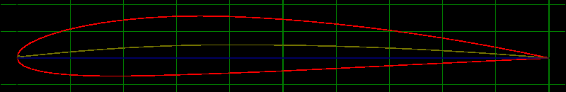
Summary
In this study, the 2D flow around an airfoil NACA 2411 is modelled:
  At several angles of attack, ranging from 0 up to 20 degrees, and incompressible flow
  (Re = 1E+06 based on the airfoil chord length, altitude: 30000 ft).
    Momentum: ‘upstream’, ‘high resolution’ schemes
    Turbulence: ‘upstream’, ‘Spalart – Allmaras’, ‘Shear Stress Transport’ schemes
  At zero angle of attack and Mach 0.9 (compressible flow).
    Momentum: ‘upstream’ scheme
    Turbulence: ‘upstream’, ‘Spalart – Allmaras’ schemes
A mesh indepence study will be performed, as well as a comparison of the results using the above momentum and turbulence schemes
Figure 1. Airfoil NACA 2411.

Slide 4
Mesh
Different sizes of mesh elements are defined on each of the four surfaces of the airfoil (front, upper, lower, rear).
‘Inflation’ is used areound the airfoil.
Two meshes are created:
  Coarse mesh:
    132131 nodes,
    15 element layers inside the boundary layer,
    element size around the airfoil: 0.001 @front, 0.002 @upper, 0.001 @lower, 0.0005 @rear.
  Fine mesh:
    324426 nodes,
    30 element layers inside the boundary layer,
    element size around the airfoil: 0.0008 @front, 0.0015 @upper, 0.0008 @lower, 0.0005 @rear.
Figure 1. Conceptual design of the BWB UAV.
Figure 3. C_{D} against Mach number.

Slide 5
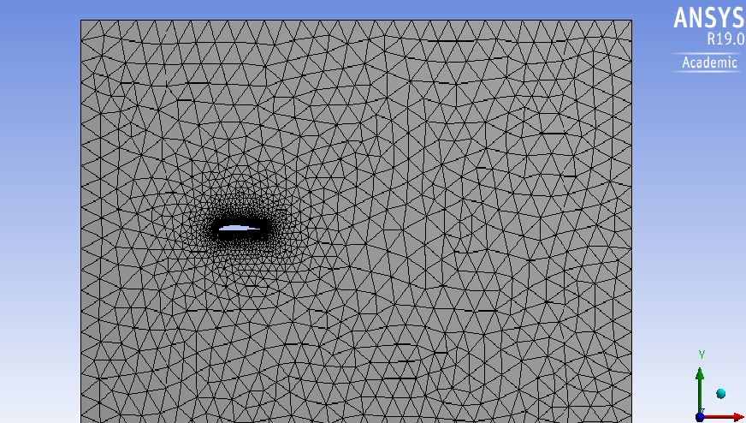
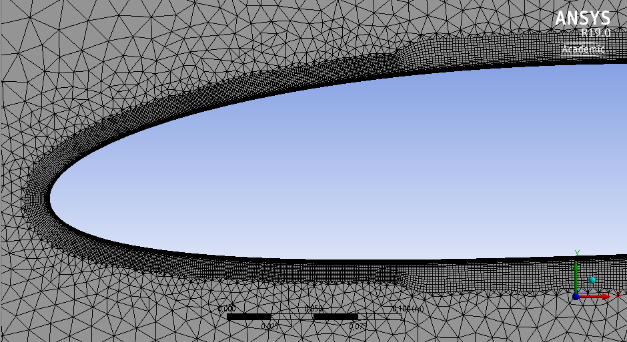
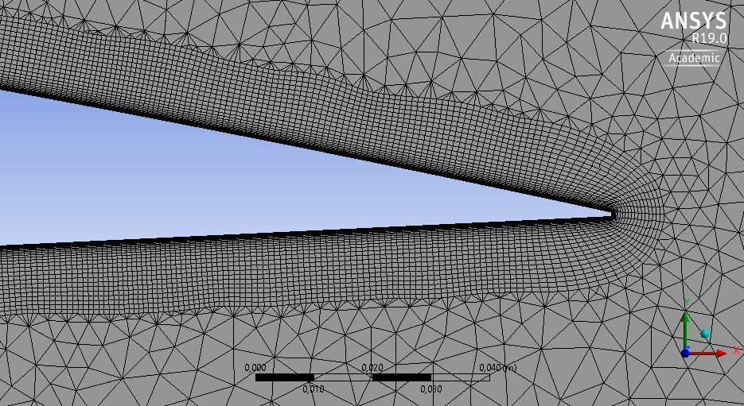
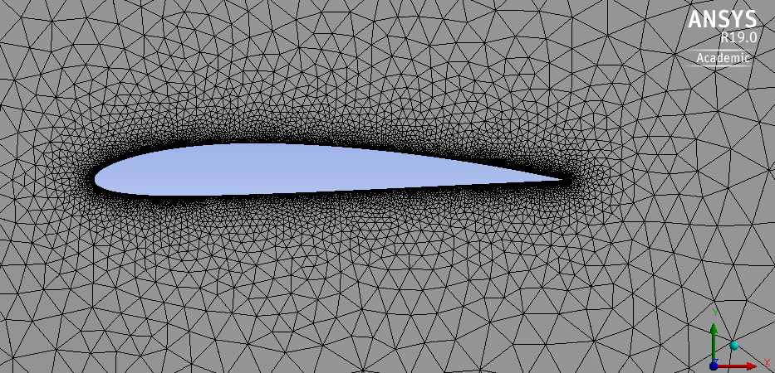
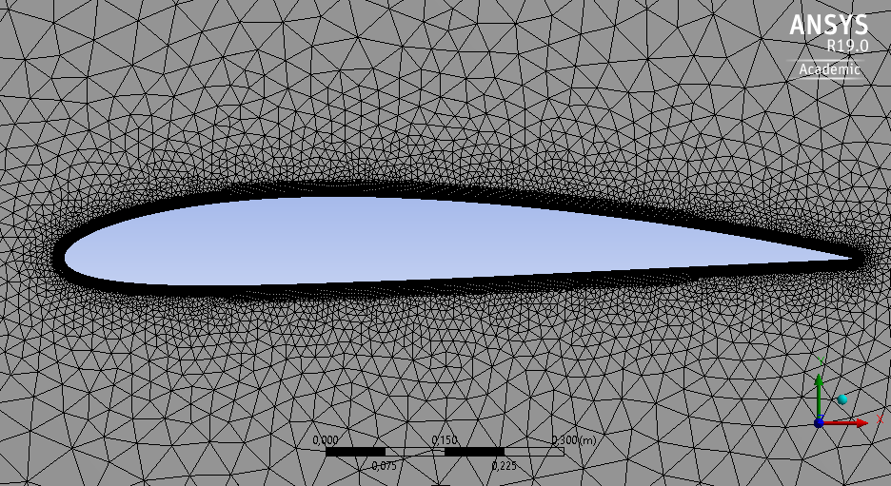
Coarse & fine mesh
Coarse mesh
  132131 nodes,
  15 element layers inside the boundary layer,
  element size around the airfoil: 0.002 - 0.0005
Fine mesh
  324426 nodes,
  30 element layers inside the boundary layer,
  element size around the airfoil: 0.0015 - 0.0005.
Figure 2. Coarse mesh.
Figure 3. Fine mesh.

Slide 6
Turbulence models
The turbulence models for RANS (Reynolds – averaged Navier-Stokes) equations are used (effect of turbulence on the mean flow properties).
  The Spalart-Allmaras tubulence model:
    Includes a transfer equation for the kinematic viscosity of turbulence,
    Includes an algebraic formula to define the length scale: 0.4187*y (y: distance from the surface).
    Is used for external aerodynamic flows.
  The k-omega SST (Menter) model is a hybrid model that includes:
    k-omega near the surface,
    k-epsilon away from the surface, where the flow is fully turbulent.
    Is also used for external aerodynamic flows.
For both turbulence and momentum equations, the upstream scheme is chosen because there is air flow.

Slide 7
Boundary conditions
The boundary conditions of the control volume change as the angle of attack changes.
Angle of attack 0°:
  Inlet: front wall, U = 31.96 m/s, V = 0.
  Outlet: rear wall, Static Pressure = 30130 Pa.
  The rest of the surfaces of the control volume are planes of symmetry.
Angle of attack 4, 8, 12, 16, 20°:
  Inlet: front and lower wall,
  U = 31.88, 31.65, 31.26, 31.72, 30.03 m/s,
  V = 2.23, 4.45, 6.64, 8.81, 10.93 m/s.
  Outlet: rear and upper wall, Static Pressure = 30130 Pa.
  The rest of the surfaces of the control volume are planes of symmetry.

Slide 8
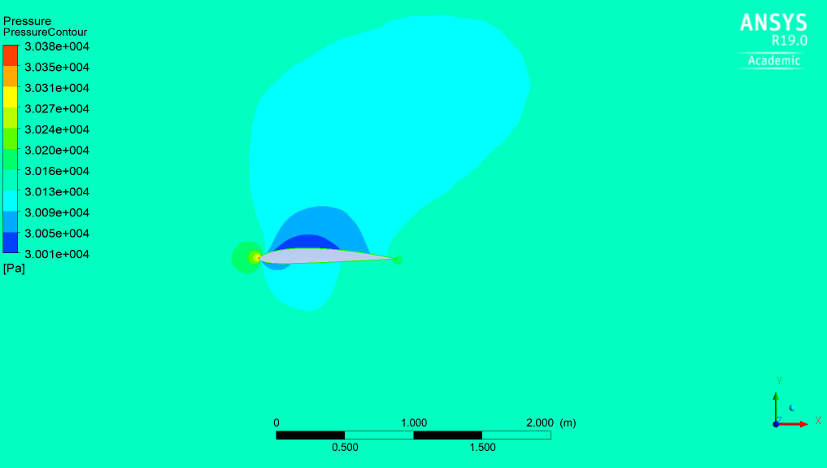
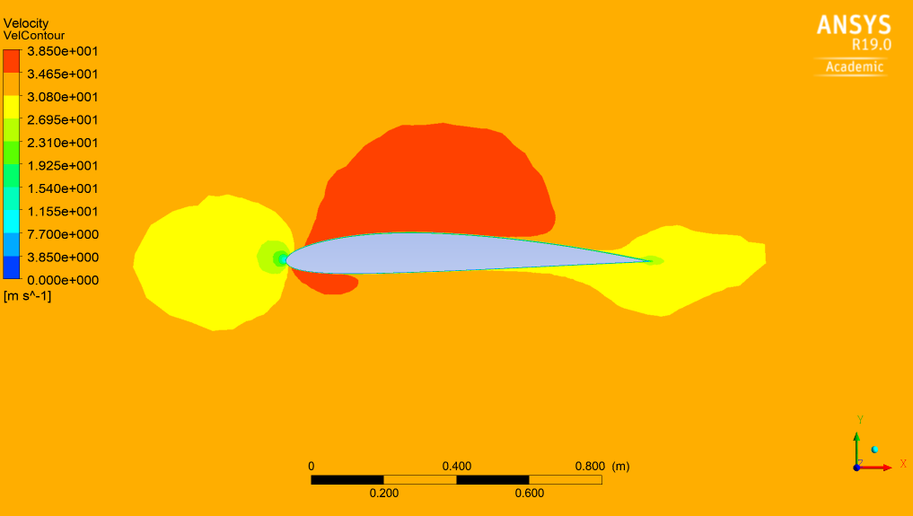
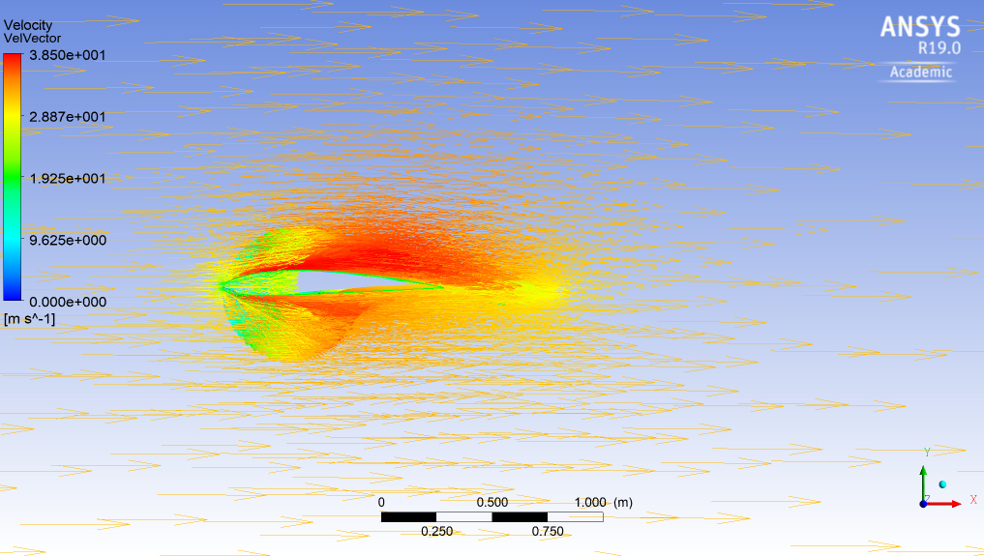
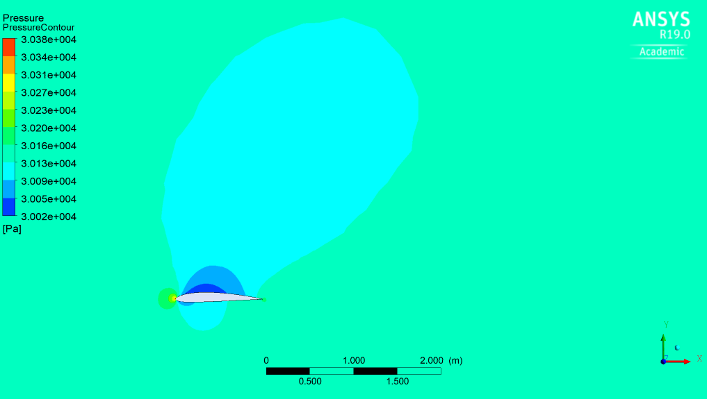
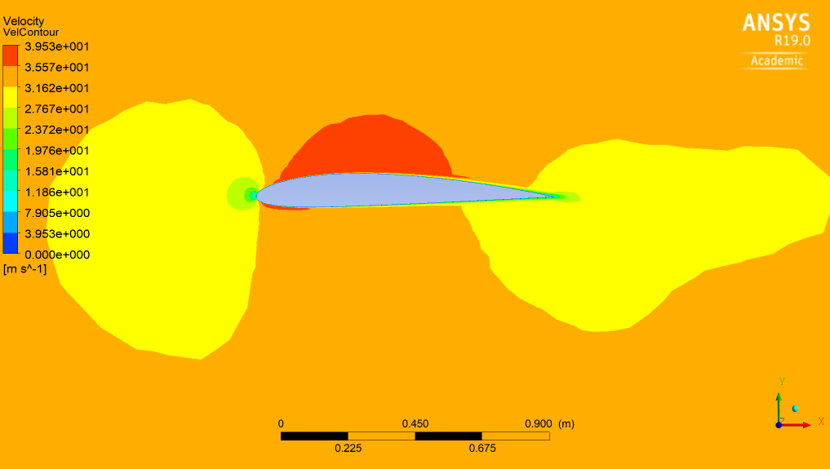
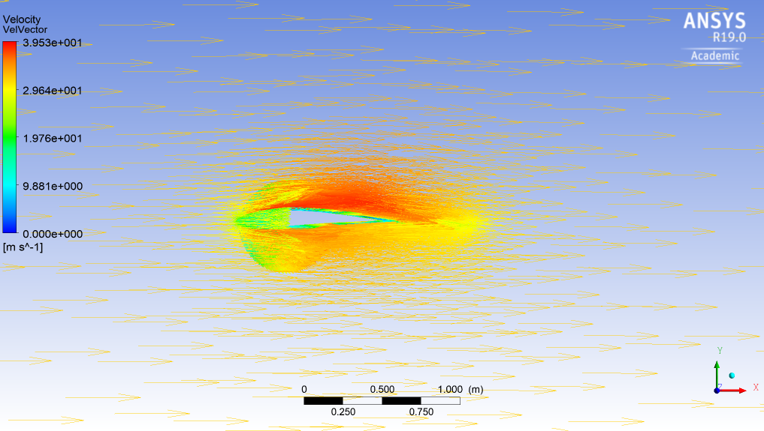
Results: Angle of attack = 0°, Spalart - Allmaras
Coarse mesh: The simulation does not reach convergence within the error margin.
Figure 4. Pressure contours, Velocity contours and Velocity vectors, at 0° angle of attack, using coarse mesh.
Fine mesh: The simulation does reach convergence within the error margin.
Figure 5. Pressure contours, Velocity contours and Velocity vectors, at 0° angle of attack, using fine mesh.

Slide 9
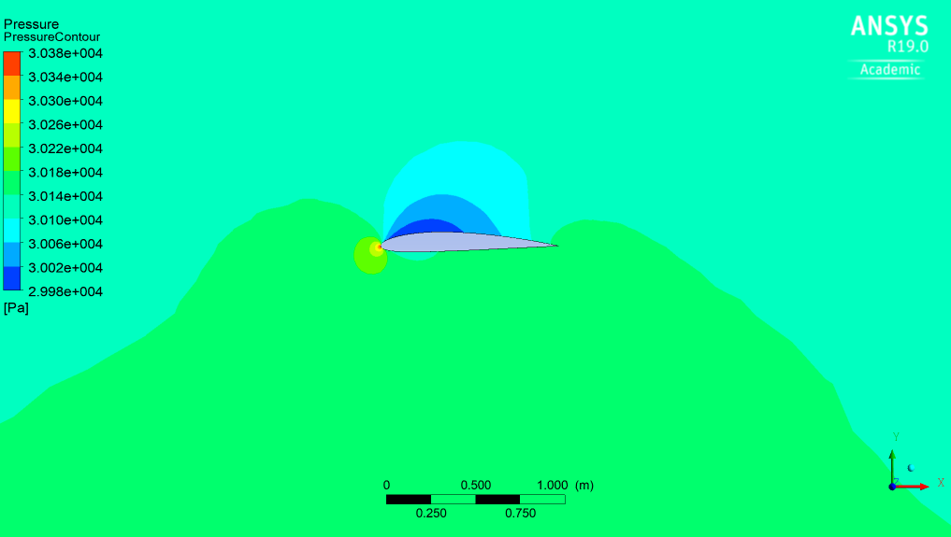
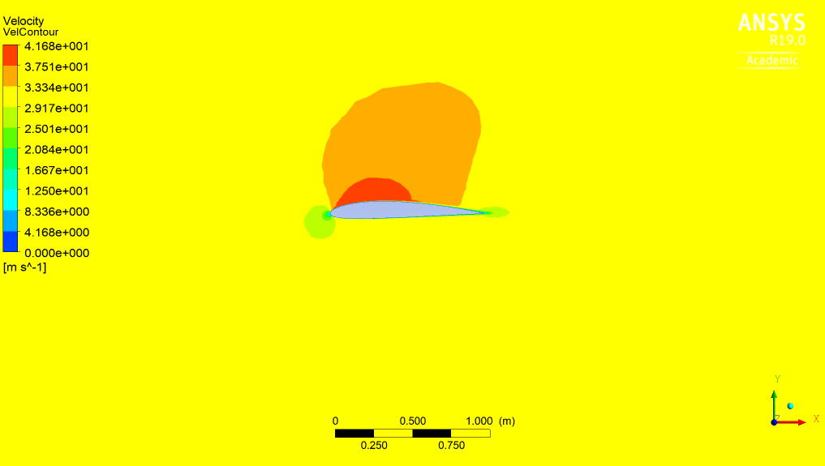
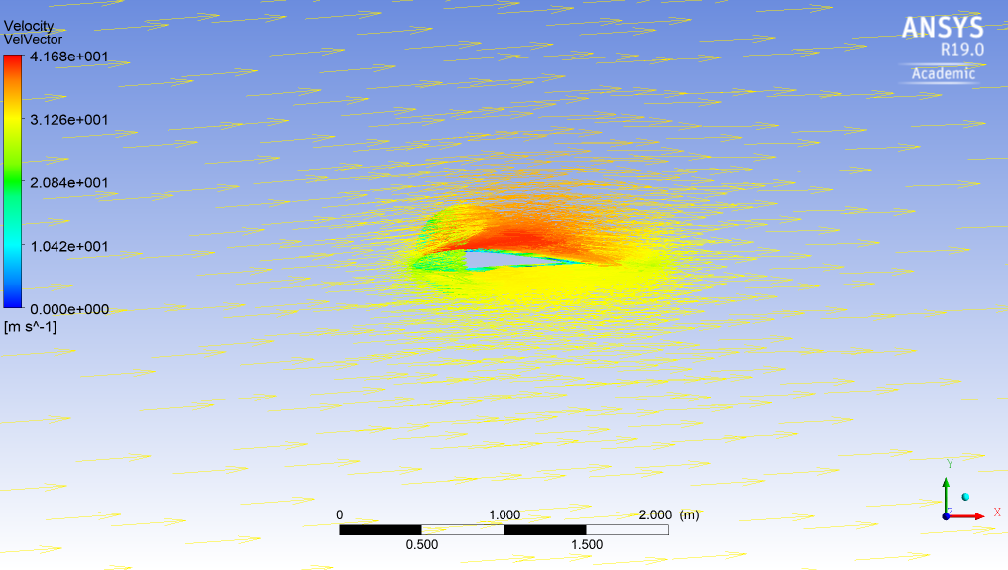
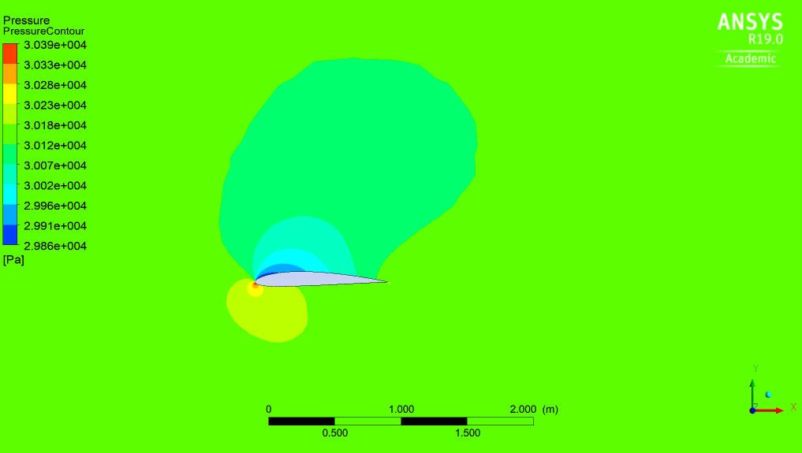
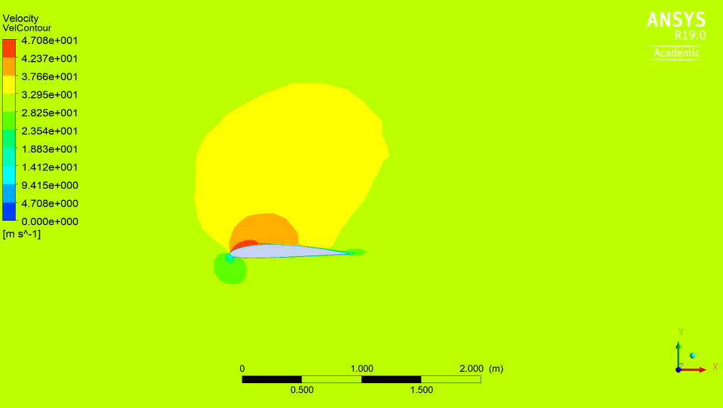
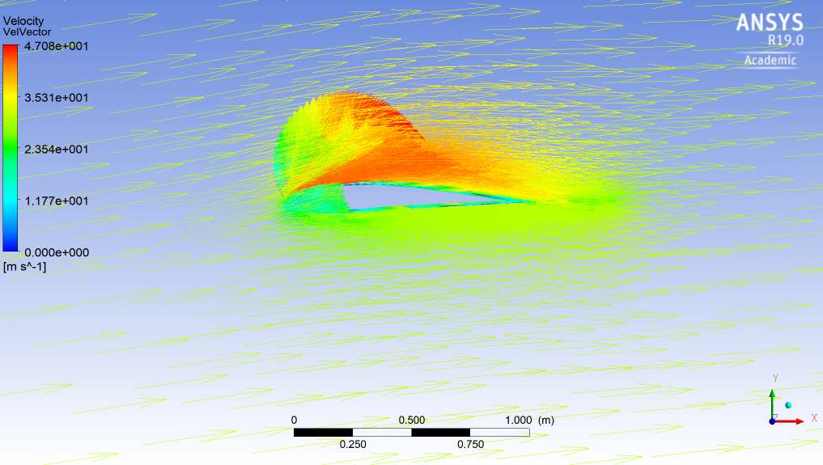
Results: Angle of attack = 4° & 8°, Spalart - Allmaras
Fine mesh: The simulation does reach convergence within the error margin.
Fine mesh: The simulation does reach convergence within the error margin.
Angle of attack = 4°
Figure 6. Pressure contours, Velocity contours and Velocity vectors, at 4° angle of attack, using fine mesh.
Angle of attack = 8°
Figure 7. Pressure contours, Velocity contours and Velocity vectors, at 8° angle of attack, using fine mesh.

Slide 10
Conclusions
An airfoil NACA 2411 was modelled using ANSYS CFX, at angle of attack: 0, 4, 8 °, and incompressible flow.
The simulation using ANSYS is very demanding with respect to simulation time and computational power. As a result, it was not possible to complete the project requirement using a personal computer, or reach convergence within the acceptable error margin.
The mesh independence study showed that a finer mesh does not benefit the simulation results (for the above angles of attack and incompressible flow), while it greatly delays the simulation. However, the results are not conclusive because convergence was not achieved in either case.

Slide 11
Bourelou Evangelia
May 2018
Thank you.
ARISTOTLE UNIVERSITY OF THESSALONIKI
FACULTY OF ENGINEERING
DEPARTMENT OF MECHANICAL ENGINEERING

